Slide 1
Patch Dynamics
AKA:
Multi-season Occupancy,
Robust Design Occupancy

Slide 2
Single-season – model assumptions
  Sites are closed to changes in occupancy state between sampling occasions
  Species are not falsely detected.
  The detection process is independent at each site
    Far enough apart to be biologically independent.
  No heterogeneity in occupancy
    than cannot be explained by covariates
  No heterogeneity in detection
    that cannot be explained by covariates

Slide 3
Basic sampling protocol same
Visit sites and spend time looking for individuals of interest or evidence that they are present
Repeated presence-absence surveys
  Temporal replication at same site
  Spatial replication

Slide 4
Important considerations
Study design
  Scope of inference
  Elements of stratification and randomization
Strength of inference!
  Strongest – experimental manipulation
  Weaker – constrained designs (e.g., before & after)
  Weaker still – a prior modeling
  Worst – a posteriori storytelling

Slide 5
Patch Occupancy Dynamics:
Pollock’s Robust Design
Hierarchical sampling scheme:
  Primary sampling periods (seasons) : long intervals between periods such that occupancy status can change
  Secondary sampling periods: short intervals between periods such that occupancy status is expected not to change

Slide 6
Robust Design Capture History
Still 2^{n} possible capture histories
History : 10 00 11 01
10 01 11 = presence in primary period 1, 3, & 4
00 =
  Patch occupied but occupancy not detected, or
  Patch not occupied (=locally extinct) yet re-colonized later

Slide 7
Occupancy dynamics
ε – local extinction
γ – colonization
(1−ε) – not extinct
(1−γ) – not colonized
1 - occupied
1 - occupied
1 - occupied
Occupancy
state
0 - unoccupied
0 - unoccupied
0 - unoccupied
season
Notes:
Changes in population size through time are a function of births, deaths, immigration, and emigration.
The open population CMR models we have considered until now have only estimated apparent survival rates.
That is, true survival, the portion of individuals surviving between sampling occasions is confounded with permanent emigration.
I spoke briefly on closed models that assume that size of the population remained unchanged between sampling events.
Robust design integrates the advantages of both types of models.
Although this model is complicated, it brings more biological reality to the analysis of population dynamics.
This method provides for the estimation of parameters that are not estimable under either open or closed models as well as more robust estimates of the familiar parameters of interest.

Slide 8
Occupancy dynamics
– dynamics (γ/ε)
>1.0 – expansion
< 1.0 contraction
1 - occupied
1 - occupied
1 - occupied
Occupancy
state
0 - unoccupied
0 - unoccupied
0 - unoccupied
season
Notes:
Changes in population size through time are a function of births, deaths, immigration, and emigration.
The open population CMR models we have considered until now have only estimated apparent survival rates.
That is, true survival, the portion of individuals surviving between sampling occasions is confounded with permanent emigration.
I spoke briefly on closed models that assume that size of the population remained unchanged between sampling events.
Robust design integrates the advantages of both types of models.
Although this model is complicated, it brings more biological reality to the analysis of population dynamics.
This method provides for the estimation of parameters that are not estimable under either open or closed models as well as more robust estimates of the familiar parameters of interest.

Slide 9
Inferring population dynamics!
Evaluate probability of extinction and colonization
– dynamics (γ/ε)
>1.0 – population expansion (increase)
<1.0 – population contraction (decrease)

Slide 10
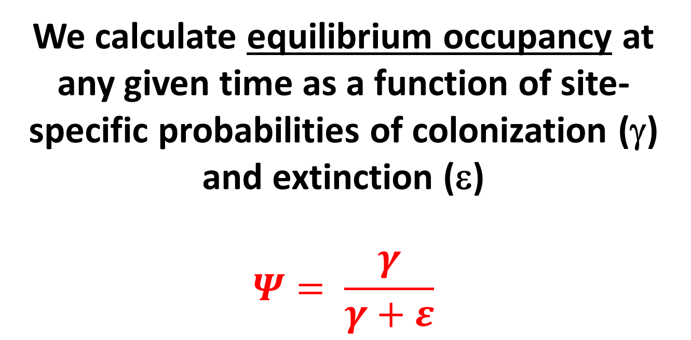
Inferring population dynamics!
Evaluate probability of extinction and colonization
We calculate equilibrium occupancy at any given time as a function of site- specific probabilities of colonization (γ) and extinction (ε)
$$Ψ= \frac{γ}{γ+ε}$$

Slide 11
Basic design
Sample over two temporal scales.
Only disadvantage - cost
  more than one sampling occasion each session.

Slide 12
Multiple seasons - main assumptions
  Species are not falsely detected.
  The detection process is independent at each site
  No unmodeled heterogeneity in occupancy
  No unmodeled heterogeneity in detection
  Closure:
    No colonization and extinction between secondary periods
    No unmodeled heterogeneity in colonization or extinction between primary periods

Slide 13
Patch Occupancy as a State Variable:
Modeling Dynamics
Model changes in occupancy over time
Parameters of interest:
  ψ – probability of occupancy
  ε_{t} – Pr(absence at time t+1 | presence at t) patch extinction probability
  γ_{t} – Pr(presence at t+1 | absence at t)
  patch colonization probability
  p_{i} – Pr(detection on occasion i) detection probability

Slide 14
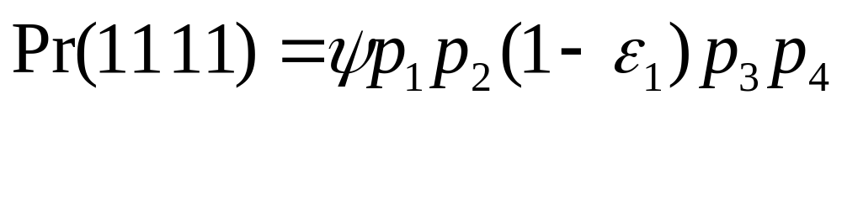
Probability models
Must account for probabilities of colonization & extinction
Examples:

Slide 15
Probability models
More examples:
Occupied and detected on first, not detected on second and then unoccupied (extinct)
OR
Occupied and detected on first, not detected on second and remained occupied but undetected on third and fourth.

Slide 16
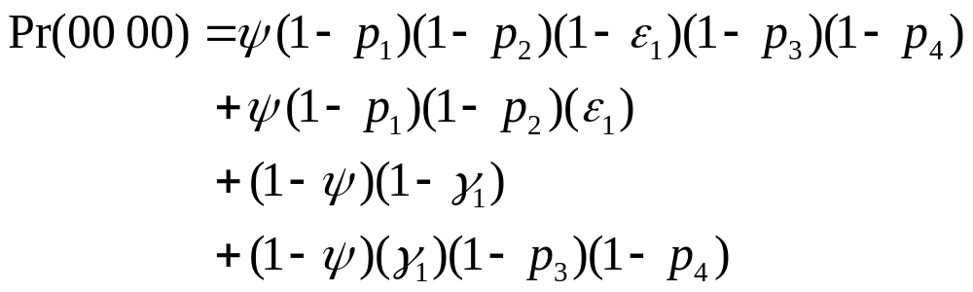
Probability models
Occupied and not detected on first and second, not extinct and not detected on second and fourth
OR
Occupied and not detected on first and second and then unoccupied
OR
Not occupied and not colonized
OR
Not occupied and colonized and undetected on third and fourth.

Slide 17
Conclusions
“Presence-absence” surveys can be used for inference when repeat visits permit estimation of detection probability
Models permit estimation of occupancy during a single season or year
Models permit estimation of patch-dynamic rate parameters (extinction, colonization, rate of change) over multiple seasons or years

